Slide 1

Smart Resume Screening & Job Matching Platform
DEPARTMENT OF ARTIFICIAL INTELLIGENCE AND DATA SCIENCE
Presented by
Guide: Vijay Anand
Presented by
M Charan Kumar - 1CR24AD060
K Harshavardhan - 1CR24AD057
B Jeevan Reddy - 1CR24AD016
Navaneeshwar - 1CR24AD058
Review: 2
Date: 26th Nov 2025

Slide 2
Contents
2
Introduction
Literature Review
Problem Statement
Objectives
Architecture Diagram
Exploratory Data Analysis(EDA) and Methodology
Implementation and Result
Conclusion
Bibliography
Department of AI & DS

Slide 3
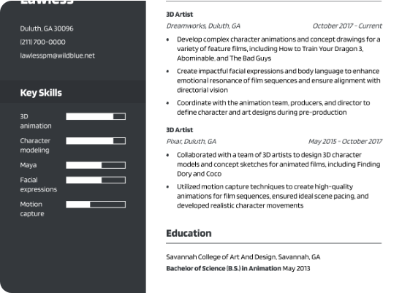
Introduction
An AI-powered resume screening and job matching platform automates candidate shortlisting using machine learning, natural language processing, and custom filtering logic.
The system enables recruiters to efficiently extract key qualifications from large volumes of resumes and match them against job descriptions for fast, unbiased hiring decisions.

Slide 4
Literature Review
SL NO | Paper Details | Dataset | Methodology Used | Gaps identified
1 | Trang, H. P., Tran, V. C., Nguyen, N. T., & Hwang, D. (2020). “Improving the performance of sentiment analysis of tweets containing fuzzy sentiment using the feature ensemble model” IEEE Access, 8(1), 14630-14641. doi: 10.1109/ACCESS.2019.2963702.
2
3 . . . 10

Slide 5
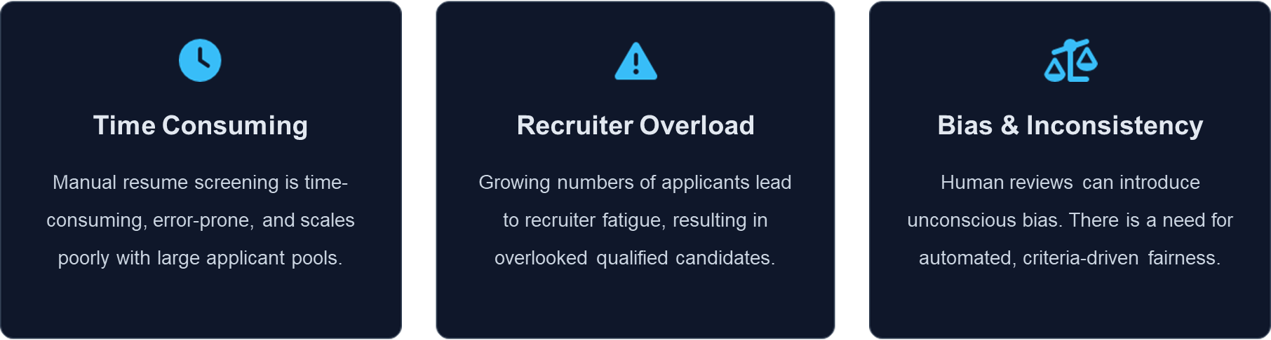
Problem Statement

Slide 6
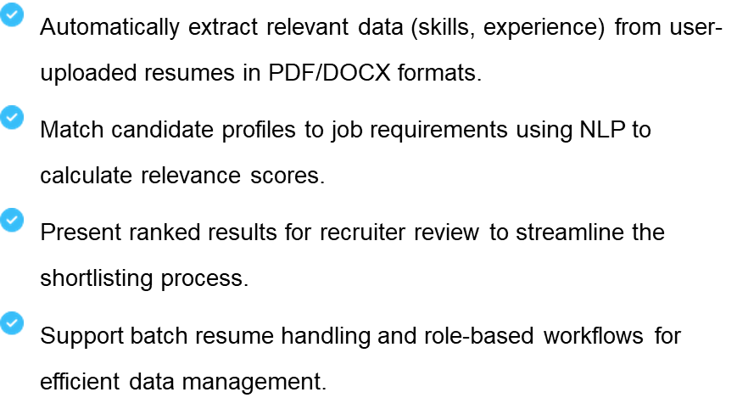
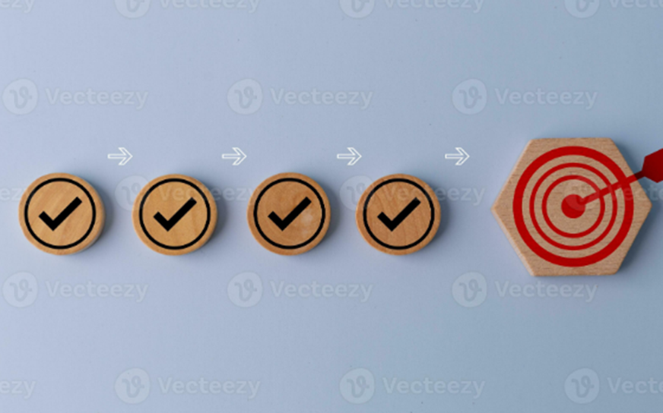
Objectives

Slide 7
Architecture Diagram
System Flow: Start
↓
Upload Resume
↓
Parse & Extract Text
↓
NLP Skill/Experience Analysis
↓
Match with Job Description
↓
Generate Fit Score & Ranking
↓
Display Results
↓
End

Slide 8
Exploratory Data Analysis(EDA)
Data Insights
Skill Distribution: Analysis of most frequent skills (Python, SQL, Java).
Experience Levels: Categorization into Entry, Mid, and Senior levels.
File Formats: Distribution of PDF vs DOCX uploads.

Slide 9
Methodology

Slide 10
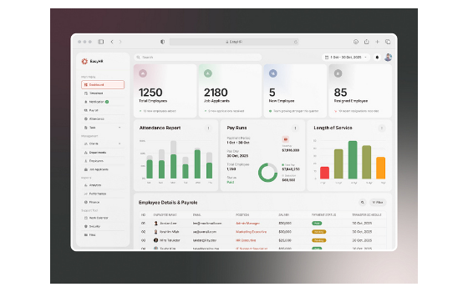
Implementation and Result
Tech Stack: Python, Flask, MySQL, spaCy. Key Outcomes:
Processed 100+ resumes in < 2 minutes.
Achieved 80% reduction in screening time.
Bias-free ranking mechanism.

Slide 11
11
Conclusion
The AI-Based Resume Screening System successfully demonstrates that automated parsing and matching can significantly enhance recruitment efficiency.
By leveraging NLP and Machine Learning, the system mitigates human bias, saves time, and provides a scalable solution for modern HR departments.
Department of AI & DS
*

Slide 12
12
Bibliography
spaCy NLP Documentation
Flask Framework Documentation
MySQL Developer Documentation
Indeed Engineering Blog – Job Matching Algorithms
Kaggle – Resume Dataset
Research Papers on NLP & Resume Parsing (BERT, ML Matching Models)
Department of AI & DS
*

